Slide 1


Adolescent Gynaecology
‘What You Need to Know in Primary Care'.
Dr Emma Park
GP trainer
Lead GP CASES project
Primary Care Sheffield
RCGP Adolescent Health Group
epark1@nhs.net

Slide 2
Outline of session
Why a different approach?
What do we see?
Overview of common problems
Summary and resource slide
Questions?

Slide 3
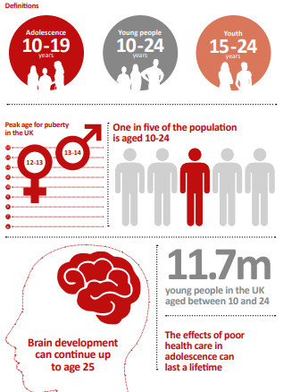
Why a different approach?

Slide 4
Adolescent Gynae
First signs of many serious longterm conditions emerge at this age.
Risk-taking behaviours begin, including sexual activity
Life-long health behaviours are set in place
Gynae problems are common but serious pathology is rare …
distress and discomfort can be significant.
Notes:
Worringly, as the hospital figures are only the tip of the iceberg, the true figure of how many children and young people are self-harming is likely to be far higher, and this is especially so for particular at-risk groups including lesbian and gay, transgender and bisexual young people, looked-after children, and young people in the criminal justice system.

Slide 5
It’s all about them
Care needs to be personalized to the young person in front of you
Contraception may be more important than diagnosis
VE/invasive investigations may be inappropriate
Fertility concerns may be an issue depending on your pt’s background

Slide 6
Top Tips
Always try to see the young person by themselves
  “Jenny will soon be a grown up and seeing me by herself so why don’t we practice today…”
Frame requests for STI screens or pregnancy tests as “something we do for all young people”

Slide 7
So, what do we see ?

Slide 8
CASES audit- what do we see in Primary care?
Clinical Assessments, Services, Education and Support-CASES
Innovative peer reviewing system in Sheffield
GPSI reviews referrals to ensure the pt gets the most appropriate care
Audit of all gynae referrals aged 16-25 since July 2016 in Sheffield
Notes:
Worringly, as the hospital figures are only the tip of the iceberg, the true figure of how many children and young people are self-harming is likely to be far higher, and this is especially so for particular at-risk groups including lesbian and gay, transgender and bisexual young people, looked-after children, and young people in the criminal justice system.

Slide 9
Notes:
Worringly, as the hospital figures are only the tip of the iceberg, the true figure of how many children and young people are self-harming is likely to be far higher, and this is especially so for particular at-risk groups including lesbian and gay, transgender and bisexual young people, looked-after children, and young people in the criminal justice system.

Slide 10
CASES Audit
Why were referrals passed on?
Complex problems
Problems which need secondary care input!
Patient/parent/GP concerns and unwillingness to pragmatically manage in the absence of a diagnosis
Notes:
Worringly, as the hospital figures are only the tip of the iceberg, the true figure of how many children and young people are self-harming is likely to be far higher, and this is especially so for particular at-risk groups including lesbian and gay, transgender and bisexual young people, looked-after children, and young people in the criminal justice system.

Slide 11
CASES Audit
Why were referrals passed back?
Conditions which can be easily managed in primary care
No STI screen done
Cosmetic concerns
First line management not attempted
Notes:
Worringly, as the hospital figures are only the tip of the iceberg, the true figure of how many children and young people are self-harming is likely to be far higher, and this is especially so for particular at-risk groups including lesbian and gay, transgender and bisexual young people, looked-after children, and young people in the criminal justice system.

Slide 12
Menorrhagia
Excessive menstrual flow in its duration (>7 days) or its volume (equates to needing to change a super pad/tampon more frequently than every two hours)
Bleeding causing symptomatic anaemia or lifestyle disturbance

Slide 13
Menorrhagia- causes
Menstrual cycles often irregular in the first years after menarche
Most are caused by anovulatory cycles related to immaturity of the hypothalamic-pituitary-ovarian axis.
Other causes include
  pregnancy, infection, the use of hormonal contraceptives, stress (psychogenic or exercise induced), under- and over-weight or weight changes
Bleeding disorders are more common.
Less common causes
  systemic illness and endocrine disorders.
Structural lesions are incredibly rare (cervical polyps and uterine leiomyomas such as fibroids).
Notes:
Young people today are growing up in a harsh environment with increasing stress to perform at school, low job prospects and the constant pressure to keep up with the latest consumer trends. And social networking, although creating ever greater circles of ‘friends’, often leaves young people feeling even more isolated and alone

Slide 14
Management
  FBC/clotting screen
  If no contraception required
    Tranexamic acid/NSAIDS 1st line
    COC
    Depo-provera
    Use for 3-6mths before trying another method/referring
Notes:
Young people today are growing up in a harsh environment with increasing stress to perform at school, low job prospects and the constant pressure to keep up with the latest consumer trends. And social networking, although creating ever greater circles of ‘friends’, often leaves young people feeling even more isolated and alone

Slide 15
Polycystic ovarian syndrome
PCOS affects 6%-7% of women
Prevalence is higher in women of South Asian origin, who have more severe symptoms and present at a younger age
Notes:
The majority of people who self-harm (usually through deliberate cutting or scratching) are aged between 11 and 25 (Mental Health Foundation, 2006; Association for Young People’s Health, 2013). However, self-harm is a very private behaviour and a very sensitive topic, which means that there is a shortage of reliable information unless young people present at accident and emergency services. A Scottish self-report survey in schools found 14% of pupils aged 15-16 years claimed to have self-harmed. It was over three times more common in girls than boys (O’Connor et al, 2009). Recent estimates from the Health Behaviour of School Aged Children survey (Brooks et al, 2015) were higher, suggesting that overall 22% of the 15 year olds in the study had self-harmed. Again, these rates were three times as high for girls (32% of girls compared to 11% of boys). The majority of those self-harming said they were doing so once a month or more.

Slide 16
What is PCOS ?
Complex endocrine disorder
Linked with insulin resistance and metabolic syndrome
Cause of PCOS is unknown
Likely to be multifactorial, with both genetic and environmental factors playing a part.
Notes:
Worringly, as the hospital figures are only the tip of the iceberg, the true figure of how many children and young people are self-harming is likely to be far higher, and this is especially so for particular at-risk groups including lesbian and gay, transgender and bisexual young people, looked-after children, and young people in the criminal justice system.

Slide 17
Rotterdam Criteria
PCOS should be diagnosed if 2/3
  Infrequent or no ovulation (usually manifested as infrequent or no menstruation).
  Clinical or biochemical signs of hyperandrogenism (ie hirsutism, acne, or male pattern alopecia), or elevated levels of total or free testosterone.
  Polycystic ovaries on ultrasonography, defined as the presence of 12 or more follicles in at least one ovary, measuring 2–9 mm diameter, or increased ovarian volume (greater than 10 mL).
Polycystic ovaries do not have to be present to make the diagnosis, and the finding of polycystic ovaries does not alone establish the diagnosis.
Notes:
Worringly, as the hospital figures are only the tip of the iceberg, the true figure of how many children and young people are self-harming is likely to be far higher, and this is especially so for particular at-risk groups including lesbian and gay, transgender and bisexual young people, looked-after children, and young people in the criminal justice system.

Slide 18
Potential Pitfalls in Adolescence
  Follicle counts are normally high after the menarche
  Anovulatory cycles soon after menarche may mimic oligomenorrhea (cycles of longer than 6 to 8 wks)
  1 year after menarche, most girls will have regular monthly menses, although girls who begin to menstruate after age 13 may take longer to establish a regular cycle.
  Oligomenorrhea at age 15 or older may be a sign of a underlying problem
  Remember 80% to 90% of adolescents have acne and 25% require pharmacological treatment
Notes:
Worringly, as the hospital figures are only the tip of the iceberg, the true figure of how many children and young people are self-harming is likely to be far higher, and this is especially so for particular at-risk groups including lesbian and gay, transgender and bisexual young people, looked-after children, and young people in the criminal justice system.

Slide 19
What do I do?
Encourage a healthy lifestyle to reduce possible long-term risks to health (type 2 diabetes and cardiovascular disease).
Emphasize that becoming overweight makes the condition worse.
Offer regular screening for impaired glucose tolerance and type 2 diabetes.
Do not initiate treatment with insulin-sensitizing drugs in primary care.

Slide 20
What do I do?
For those with oligomenorrhoea or amenorrhoea:
Exclude pregnancy
Induce a withdrawal bleed with a 12day course of medroxyprogesterone
Get u/s to assess endometrial thickness..
If the ET is less than 10mm, advise treatment to prevent endometrial hyperplasia.
Offer either regular withdrawal bleeding at least once every 3 months (using COC or cyclical progestogen) or the mirena

Slide 21
Amenorrhoea
Primary amenorrhoea - failure to establish menstruation by 16 years of age in women with normal secondary sexual characteristics, or by 14 years of age in women with no secondary sexual characteristics
Secondary amenorrhoea - the absence of menstruation for at least 6 months in women with previously normal and regular menses, or for 12 months in women with previous oligomenorrhoea
Notes:
The majority of people who self-harm (usually through deliberate cutting or scratching) are aged between 11 and 25 (Mental Health Foundation, 2006; Association for Young People’s Health, 2013). However, self-harm is a very private behaviour and a very sensitive topic, which means that there is a shortage of reliable information unless young people present at accident and emergency services. A Scottish self-report survey in schools found 14% of pupils aged 15-16 years claimed to have self-harmed. It was over three times more common in girls than boys (O’Connor et al, 2009). Recent estimates from the Health Behaviour of School Aged Children survey (Brooks et al, 2015) were higher, suggesting that overall 22% of the 15 year olds in the study had self-harmed. Again, these rates were three times as high for girls (32% of girls compared to 11% of boys). The majority of those self-harming said they were doing so once a month or more.

Slide 22
Primary Amenorrhoea
Refer for specialist investigation & management
those who have no secondary sexual characteristics & who have not started menstruating by 14 years of age.
those with normal secondary sexual characteristics & who have not started menstruating by 16 years of age.
Growth retardation.
Symptoms and signs of androgen excess (such as hirsutism) or thyroid disease & amenorrhoea.
Galactorrhoea.
Suspected genital tract malformation, intracranial tumour (for example prolactinoma), chromosomal anomaly (eg Turner's syndrome or androgen insensitivity), or anorexia nervosa.
Puberty lasting 5 years without menarche (eg example presenting at 15 years of age when pubic hair and breast development started at 10 years of age).

Slide 23
Secondary Amenorrhoea
Manage in primary care:
Polycystic ovary syndrome
Hypothyroidism — menses may take several months to resume with treatment.
Pregnancy
Refer to a gynaecologist
Elevated FSH/LH x2— which suggests premature ovarian failure in women younger than 40 years of age.
Recent history of uterine/cervical surgery/pelvic infection- Asherman's syndrome or cervical stenosis.

Slide 24
Secondary Amenorrhoea
Refer to an endocrinologist
Hyperprolactinaemia: serum prolactin level greater than 1000 mIU/L, or 500–1000 mIU/L x2 even if on drugs known to raise PL.
Low FSH/LH levels (to exclude hypopituitarism or a pituitary tumour, although stress, excessive exercise, or weight loss are more likely causes).
Increased testosterone level that is not explained by PCOS(suggesting an androgen-secreting tumour, late-onset congenital adrenal hyperplasia, or Cushing's syndrome).
Other features of Cushing's syndrome or late-onset congenital adrenal hyperplasia (besides an increased testosterone level).

Slide 25
Osteoporosis Risk
At risk
  premature ovarian failure
  hypothalamic amenorrhoea (eg wt loss or excessive exercise),
  hyperprolactinaemia
Treat the underlying cause, if possible.
Assess fracture risk
Correct vitamin d deficiency and ensure an adequate calcium intake (vegans!)
Offer HRT/COC if amenorrhoea persists for more than 12 months.
Review treatment at least annually.
Those with amenorrhoea due to reversible causes (such as weight loss or excessive exercise), stop HRT/COC (eg after 6-12mths) to see if menses return

Slide 26
Vulval concerns
Labial growth and development is part of pubertal development and may not be completed until early adulthood

Slide 27
Labiaplasty-a growing problem
5x increase in NHS operations in last 10yrs
  2015-16 over 200 girls under 18 had labiaplasty, 150 under 15.
Female genital cosmetic surgery(FGCS)
cosmetic surgical procedures which change the structure and appearance of the healthy external genitalia of women.
Includes labiaplasty which involves the lips of the vagina being shortened or reshaped.
Increase linked with the rise in the use of porn

Slide 28
Labiaplasty-a growing problem
RCOG position statement
“Owing to anatomical development during puberty, FGCS should not normally be offered to individuals below 18 years of age.”
WHO describes Female Genital Mutilation (FGM) as comprising
“all procedures that involve partial or total removal of the external female genitalia, or other injury to the female genital organs, for non-medical reasons.”

Slide 29
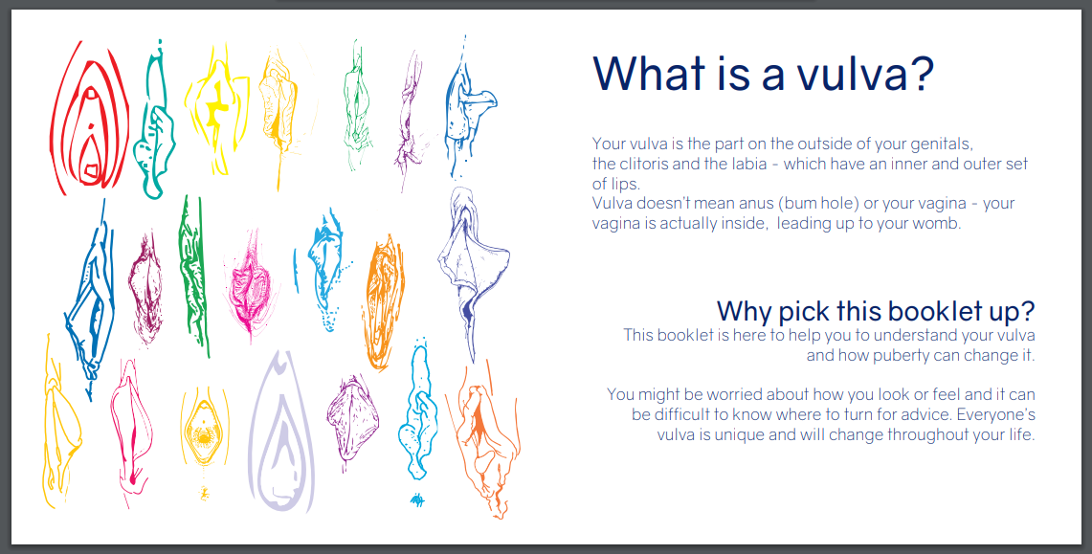
Brook and BritSPAG leaflet

Slide 30
Pelvic Pain
“Every woman of child bearing age is pregnant until proven otherwise.
Every woman who is pregnant is an ectopic until proven otherwise”

Slide 31
Dysmenorrhoea
Primary Dysmenorrhoea (pain from 6mths post menarche)
  Pain starts just before period, and lasts for up to 72 hours, improving as the menses progresses.
  Non-gynaecological symptoms such as nausea, vomiting, migraine, bloating, and emotional symptoms are present.
Notes:
http://www.rcgp.org.uk/clinical-and-research/toolkits/the-rcgp-nspcc-safeguarding-children-toolkit-for-general-practice.aspx

Slide 32
Dysmenorrhoea
Secondary dysmenorrhoea
  symptoms started after several years of painless periods.
  Other gynaecological symptoms
    dyspareunia, vaginal discharge, menorrhagia, intermenstrual bleeding, & postcoital bleeding.
  Other non-gynaecological symptoms that suggest a secondary cause, for example rectal pain and bleeding which may be associated with endometriosis.
Notes:
http://www.rcgp.org.uk/clinical-and-research/toolkits/the-rcgp-nspcc-safeguarding-children-toolkit-for-general-practice.aspx

Slide 33
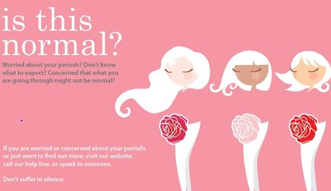
“3 in 4 women or young women experience strong period pains. Your period pain should not be so bad that you cannot get up, go to school or college and carry on with your normal life. “
Endometriosis UK
Notes:
http://www.rcgp.org.uk/clinical-and-research/toolkits/the-rcgp-nspcc-safeguarding-children-toolkit-for-general-practice.aspx

Slide 34
Management
Empirical treatment with NSAIDs/COC/Progesterones for at least 6mths
Consider endometriosis in those who don’t respond to initial management and refer
BUT
Bear in mind that gold standard for diagnosis is laparoscopy
Only large deposits will show on u/s
Notes:
http://www.rcgp.org.uk/clinical-and-research/toolkits/the-rcgp-nspcc-safeguarding-children-toolkit-for-general-practice.aspx

Slide 35
Ovarian Cysts
Usually found on a routine scan for another cause in this age group

Slide 36
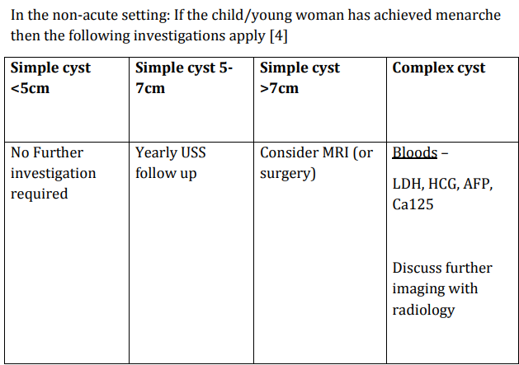
Ovarian Cysts-BritSPAG guideline
Notes:
http://www.rcgp.org.uk/clinical-and-research/toolkits/the-rcgp-nspcc-safeguarding-children-toolkit-for-general-practice.aspx

Slide 37
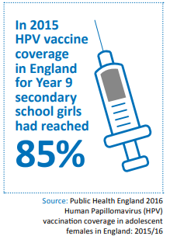
Ectropions and unscheduled bleeding

Slide 38
Cervical Ectropion
Always remember STI!!
Can self swab
Check HPV vaccine history
  ectropion can be a normal variant if hyperoestrogenised ie menarche/OCP
  refer only if bleeding persistent
But 2ww criteria different in different areas so be aware of local guidance
Notes:
Appointment times
outside school hours, lunchtimes
flexibility re booking…..all telephone triage isn’t practical if at school / college and a lot of young people don’t like talking on the phone
How can YP get to the surgery
advertise bus routes, bus stops, other public transport (we have a metro line near us)
Arrange appointments for f/up.. Consider, if you can, doing it yourself rather than sending YP back to the desk……follow up if they don’t come back (telephone / txt.. Ensure right mobile number)
Text reminders……who’s contact details are on their records…. Often a parent…….who do they want to be contacted ?themselves ?parent / guardian
think about mobile / texting / ?email
Ensure YP can register easily
Work with your reception team to make young people's registration easier.
Vulnerable young people such as those leaving care or the criminal justice system, refugees and the homeless are sometimes denied registration as they lack the correct documentation and proof of address

Slide 39
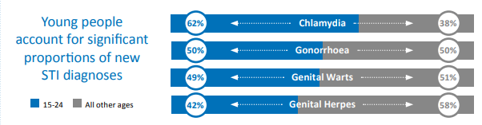

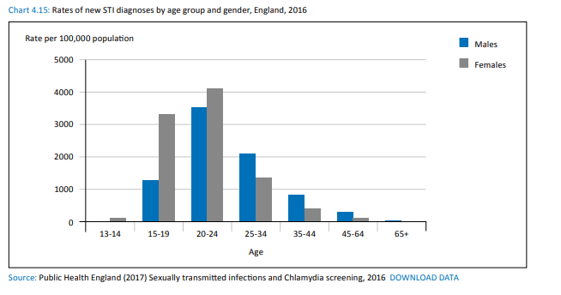
STI
Notes:
DoH 2011………https://www.gov.uk/government/publications/quality-criteria-for-young-people-friendly-health-services
pilot 2017… pilot criteria http://www.youngpeopleshealth.org.uk/yourewelcome/
RCN leaflet being reviewed in 2017 https://www.rcn.org.uk/professional- development/publications/pub-004509
Local quality criteria……eg South Tyneside…change for life
RCGP bright ideas http://www.rcgp.org.uk/bright-ideas......ideas of what practices have done PACE setter, south east coast

Slide 40
Resources/References
British Society for Paediatric and Adolescent Gynaecology
http://www.britspag.org/?q=content/leaflets
Brook and BritSPAG leaflet
https://www.brook.org.uk/shop/product/so-what-is-a-vulva-anyway
NICE/CKS
https://cks.nice.org.uk/amenorrhoea#!topicsummary
https://cks.nice.org.uk/polycystic-ovary-syndrome#!topicsummary
https://cks.nice.org.uk/endometriosis#!background
https://cks.nice.org.uk/menorrhagia#!scenario
https://cks.nice.org.uk/dysmenorrhoea#!scenariorecommendation
RCOG/BritSPAG position statement
https://www.rcog.org.uk/globalassets/documents/guidelines/ethics-issues-and-resources/rcog-fgcs-ethical-opinion-paper.pdf
http://www.britspag.org/sites/default/files/downloads/Labiaplasty%20%20final%20Position%20Statement.pdf
AYPH
http://www.youngpeopleshealth.org.uk/
Youth health Talk
http://www.healthtalk.org/young-peoples-experiences/sexual-health/topics
Endometriosis UK
https://www.endometriosis-uk.org/sites/default/files/files/campaign%20materials/is-this-normal-leaflet-period-Feb2014-read.pdf
Notes:
Appointment times
outside school hours, lunchtimes
flexibility re booking…..all telephone triage isn’t practical if at school / college and a lot of young people don’t like talking on the phone
How can YP get to the surgery
advertise bus routes, bus stops, other public transport (we have a metro line near us)
Arrange appointments for f/up.. Consider, if you can, doing it yourself rather than sending YP back to the desk……follow up if they don’t come back (telephone / txt.. Ensure right mobile number)
Text reminders……who’s contact details are on their records…. Often a parent…….who do they want to be contacted ?themselves ?parent / guardian
think about mobile / texting / ?email
Ensure YP can register easily
Work with your reception team to make young people's registration easier.
Vulnerable young people such as those leaving care or the criminal justice system, refugees and the homeless are sometimes denied registration as they lack the correct documentation and proof of address

Slide 41
Outline of session
Why a different approach?
What do we see?
Overview of common problems
Summary and resource slide
Questions?

Slide 42
Thank you
Contact details
Dr Emma Park
epark1@nhs.net

